Slide 1
CALÉO MENESES SANTOS - A I / M L S O F T W A R E D E V E L O P E R
A C A D E M I C E D U C A T I O N
UNDERGRADUATE STUDENT OF ELECTRICAL ENGINEERING
Federal University of Bahia (UFBa) | Started in November 2016 - July, 2023
TECHNICAL IN INDUSTRIAL AUTOMATION
Federal Institute of Bahia (IFBa) | 2013-2017
W O R K E X P E R I E N C E
P R O G R A M I N G L A N G U A G E S
Python JavaScript Bash
D E V T O O L S
Git / Github Jupyter Lab
Visual Code Studio SonarQube
Docker Flask
A I / M L
F R A M E W O R K S
Pytorch Tensorflow/Keras OpenAI Gym
F O R D A I T O O L S
High Processing Computer (HPC) Domino
Mach1 Datarobot
L A N G U A G E S
English- C1 Level German - A1 Level
SOFTWARE DEVELOPER - ENTERPRISE CONNECTIVITY
Developing a new authorial model in EVD (emergency vehicle detection) in Palo Alto
2 ML models based on EVD papers implemented
Working and benchmarking with an exterior voice classification ML model of a supplier (Syntiant)
+10K EVD Audio files Dataset preprocessed and Curated Automatic Papers Web Scraping in Science Direct site
Development in Machine Learning with TensorFlow and Docker Containers @ High Processing Computer (ML HPC - Ford)
Introduction in Domino and Mach1 Platforms
Anomalous Behavior Detection in IoT Script with BigQuery GCP @ Ford GCP Hackathon
Synthetic Data Generation for Connected Vehicle Recommendation System with Python and Eclipse SUMO
SOUTH AMERICA TRANSIT - PROGRAM MANAGEMENT INTERN
Concerns Release in WERS and BOM Fix
Follow-up of Projects in international Part Numbers tracking
Leading meetings with teams from India, Turkey, Argentina and the United States
SOUTH AMERICA EESE INTERN
Support to the South America Product Development Team Audio System Improvement project in Troller Vehicle
Ago 2021 -
Current
GI Group @ Ford
Company
2020 - Jul 2021
Ford Company
Intern

Slide 2
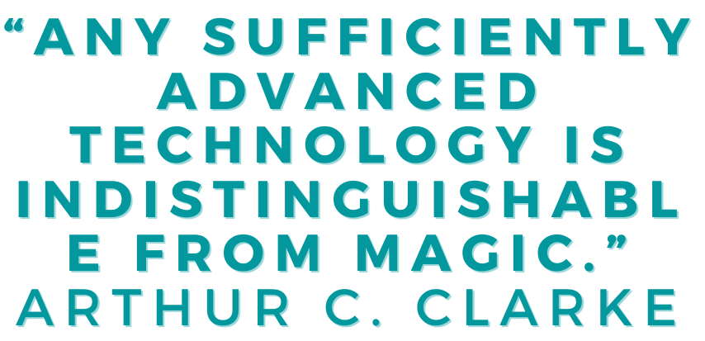
CALÉO MENESES SANTOS
H A K C K A T H O N & A W A R D S
FORD GLOBAL HACKATHON - DATA POWER FINALISTS
"Road Danger Alert" Team | 2022
FORD SOUTH AMERICA HACKATHON - TOP #10 AWARD
FORD+ CONNECTED "Show me the Data" Team | 2022
FORD GCP HACKATHON - FAVORITE AUDIENCE AWARD
Smart Hub Project - "Ford in the Cloud with Diamonds" Team | 2021
Innovation Award (AUTONOMOS ROBOT WITH COMPUTER VISION) - Regional Stage
Brazilian Olympics Robotics Practical Modality - Autobot Team | 2015
N E W S K I L L S I N T H E L A S T 6 M O N T H S
QA/QC: Behavior tests (AI/ML Unit Tests), Python Unit Tests, SonarQube
IA/ML: Pytorch and Ensemble Learning
Data: H5 Data File management, Connected Vehicle Extraction
High Processing Computer: Domino
Extra: _Exponential Thinking course at Singularity University (SA Ford Hackathon Award)
A C H I E V E M E N T S A N D C O U R S E S
(B1 -> C1) fluency in English (from the internship to the present day)
_Exponential Thinking course at Singularity University (SA Ford Hackathon Award)
Python QA/QC guidelines SPOC
AI/ML Guild administration with +10 presentations and an average of 20 participants per week.
AI/ML Guild repo created with all new presentations
Deep Learning Meeting “Demystifying IA/ML” presentation for Enterprise Connectivity team
22 years old
Housing in Salvador / BA - Brazil
+55 71 99169 5316
linkedin.com/in/caleomeneses/ github.com/caleo-hub
github.ford.com/csant321
Y O U N G
V I S I O N A R Y
S O F T S K I L L S
Continuous learning in challenges in different contexts (ML, QA/QC, Data Management)
Creativity and Innovation structured with courses and applied in hackathons/brainstorms
Focus on results through continuous deliveries in projects developed in the team
Efficient communication and management working on delegated projects like NA work and AI/ML Guild Collaboration and team spirit with the software team, often aiming to help colleagues on and off projects.

